Slide 1

Chapter 1:
Introduction to Data understanding
Notes:
‹#›

Slide 2
Introduction to Data understanding
Objective
Data Understanding is a crucial phase in data mining, it involves gaining insights from data and making informed decisions.
Key objectives include identifying data objects, attributes, using statistics and visualization.
Data Understanding sets the foundation for data preprocessing and modeling.
‹#›

Slide 3
Introduction to Data understanding
Data Understanding - Objects & Attributes, Statistics, Visual
Data Objects: Elements in a dataset (e.g., records, data points).
Data Attributes: Characteristics or features of data objects.
Descriptive Statistics: Measures to summarize and analyze data.
Data Visualization: Techniques for visually exploring data.
These elements are essential for gaining insights from data and making informed decisions in data mining.
‹#›

Slide 4
Introduction to Data understanding
Data Objects
Data objects are individual elements within a dataset.
Examples of data objects include records, instances, and data points.
Understanding data objects is fundamental for effective data analysis and modeling.
They represent the entities about which we collect data, and they can vary in complexity based on the context of the dataset.
‹#›

Slide 5
Introduction to Data understanding
Data Attributes
Data attributes are characteristics or features associated with data objects.
Types of data attributes include nominal, ordinal, and numeric.
Understanding data attributes is crucial for data analysis, as they define the information we collect about data objects.
The type and nature of attributes influence the methods used for data processing and analysis.
‹#›

Slide 6
Introduction to Data understanding
Descriptive Statistics
Descriptive statistics are essential for summarizing and analyzing data.
They provide key insights into data distributions and patterns.
Common measures include mean, median, mode, variance, and standard deviation.
Descriptive statistics help in understanding the central tendency and variability within data, aiding in informed decision-making and data interpretation.
‹#›

Slide 7
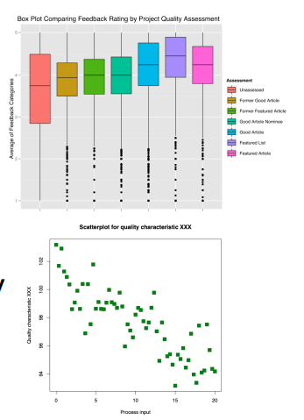
Introduction to Data understanding
Data Visualization
Data visualization is a powerful technique for exploring and presenting data.
It helps in understanding complex datasets through visual representations.
Various types of data visualizations, such as charts, graphs, and maps, are available.
Choosing the right visualization method depends on the nature of the data and the insights you want to convey.
‹#›

Slide 8
Introduction to Data understanding
Data Understanding - Data Similarity
Data Similarity is a critical concept in data analysis.
It involves measuring the resemblance or closeness between data points.
Data similarity is essential for tasks like clustering, classification, and recommendation systems.
In this course, we will explore various measures of data similarity and their applications.
‹#›

Slide 9
Introduction to Data understanding
Measures of Data Similarity
Data similarity is quantified using specific measures.
Common measures include:
  Euclidean Distance
  Cosine Similarity
  Jaccard Similarity
  Pearson Correlation Coefficient
Each measure has its use cases and is suitable for different types of data analysis.
‹#›

Slide 10
Introduction to Data understanding
Euclidean Distance
Euclidean Distance is a measure of similarity between data points.
It calculates the straight-line distance between two points in a multidimensional space.
Often used for numeric data, it quantifies the "as-the-crow-flies" distance.
Euclidean Distance is a foundational concept in data analysis and clustering tasks.
‹#›

Slide 11
Introduction to Data understanding
Cosine Similarity
Widely used in text mining and recommendation systems.
It quantifies the similarity of direction rather than magnitude, making it suitable for various data types.
Cosine Similarity helps identify similarities in content and preferences, making it valuable in diverse applications.
‹#›

Slide 12
Introduction to Data understanding
Jaccard Similarity
Jaccard Similarity is used to measure the similarity between sets.
It calculates the size of the intersection divided by the size of the union of two sets.
Widely applied in text analysis, recommendation systems, and social network analysis.
Jaccard Similarity is effective for capturing shared elements in data, particularly in scenarios involving categorical or binary attributes.
‹#›

Slide 13
Introduction to Data understanding
Pearson Correlation Coefficient
Pearson Correlation Coefficient quantifies the linear relationship between two numeric variables.
It measures the strength and direction of the linear association.
Widely used for analyzing correlation and dependence between variables.
Pearson's correlation is valuable in fields like statistics, economics, and social sciences for assessing relationships in data.
‹#›

Slide 14
Introduction to Data understanding
Applications of Data Similarity
Data similarity measures are essential in various data-driven tasks.
Applications include:
Clustering: Grouping similar data points together.
Classification: Assigning data points to predefined categories.
Recommender Systems: Suggesting relevant items based on user preferences.
These measures enable data-driven decision-making and personalized user experiences.
‹#›

Slide 15
Introduction to Data understanding
Summary
Data Understanding: Crucial in data mining for insights and informed decisions.
Data Objects & Attributes: Elements and characteristics of data.
Descriptive Statistics: Measures for summarization and analysis.
Data Visualization: Visual exploration and communication of data.
Data Similarity: Measuring data resemblance for various applications.
Key Measures: Euclidean, Cosine, Jaccard, and Pearson.
Applications: Clustering, classification, recommendation, and more.
Harnessing data understanding and similarity for effective data analysis and decision-making.
‹#›

